Slide 1
Content Pages in SharePoint Sites Web Part Pages, Web Parts & More

Slide 2
Agenda
The Purpose of Pages and Web Parts
A Tour of Default Web Parts
Connecting Web Parts
Targeting Web Parts

Slide 3
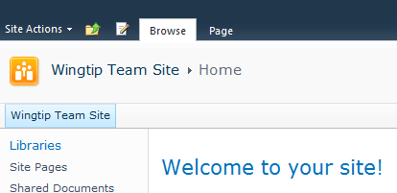
The Purpose of Pages and Web Parts
http://wingtipserver/sitepages/home.aspx
Notes:
In order to browse a web site of any kind, including SharePoint, the client software performing as the human interface must access a web page within the site in order to render graphics on the screen. When you browse a web site, you are really rendering a given web page from that site in your web browser application.
When you visit a SharePoint web site you may be used to seeing links, menus, lists, libraries, and even pictures or images on the web page rendered in your web browser application. So it is easy to associate those lists, libraries, et cetera with the page being rendered. But SharePoint container objects like lists and libraries and the item objects within, such as individual pictures or documents, are components of the site itself not the web page you happen to be viewing. The web page is merely the messenger who delivers said objects to your screen.
Every SharePoint site template creates a site with at least one page (usually named default.aspx) to get you started. But when that page becomes too congested with content displays to be useful, you may find it necessary to add supplemental web pages to the site and move some of the content displays from the overcrowded default page of the site onto the supplemental web pages.

Slide 4
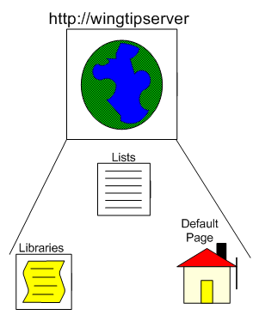
Sites
Sites contain pages, lists, libraries, workflows, galleries, and more.
Access to these objects through a browser requires a web page file that can be rendered graphically
Programmatic access to these objects can be accomplished with SharePoint compliant development applications
Notes:
SharePoint manages user content in organized lists, libraries and galleries. Special lists on a site, called galleries, even contain very influential site configuration items such as list templates or site content types. But the SharePoint site itself is really just the host and governor of these content objects, not the deliverer. For humans to browse these objects, to actually look at a Tasks list full of items in Internet Explorer, web pages are needed.
Web pages of a SharePoint site are stored in one of the site’s libraries and are written to expose particular objects from the site when rendered graphically in a web browser application. SharePoint offers several page layout templates to help you design a new web page for the site and provides a bevy of ASP.NET-based web parts to help populate the web page with code and functionality. More on that later.
NOTE: Office applications can expose SharePoint content in the form of Outlook lists, calendars, discussion boards or in the form of actual data file items opened in their associated application such as Word or Excel. Also, developers can access SharePoint site objects programmatically using a SharePoint-compliant editing or programming application (such as SharePoint Designer 2010 or Visual Studio 2010).

Slide 5
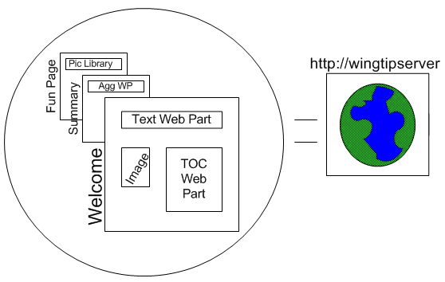
Pages
Notes:
Web pages within a given SharePoint site can provide many different views of the content stored on the site. For example, every list and library in a SharePoint site has an associated web part in the site’s web part gallery. That web part’s only job is to expose its associated list or library. If you add, say, the Pic Library’s web part to the Fun Page of the site in the illustration above, that library’s items can be seen on the Fun Page (as well as by visiting one of the view pages of the library, such as AllItems.aspx).
Because we actually “see” the items of the Pic Library on the Fun Page in this scenario, some users find it difficult to separate the library from the page itself. They will tend to think of the Fun Page’s web part or one of the library’s view pages (such as AllItems.aspx) as being the library itself. But the library exists separately from its exposing web pages. It is an object in the web site and can only be accessed directly using SharePoint Designer 2010 or Visual Studio 2010.
Web Parts, on the other hand, are pluggable sets of code that can be easily added to (or removed from) web part zones defined on a SharePoint web part page to change the page’s functionality. SharePoint web pages are written in ASP.NET, a programming language not fluent to most site administrators. Imagine having to rewrite a web page in its entirety every time you wanted to add or subtract some exposed content. This would prove time consuming and counter-productive to be sure, and likely be very challenging.
But web parts are chunks of pre-written, configurable ASP.NET code neatly packaged as a named item in a web part gallery. When a site administrator needs a particular web part’s functionality on a web page they simply add the web part and configure its settings.

Slide 6
DEMO
Working with Web Part Pages
Notes:
In this demonstration, your instructor will illustrate:
Differences between sites and pages and between pages and lists
How to create additional pages into a site
How to add web parts to a page

Slide 7
Agenda
The Purpose of Pages and Web Parts
A Tour of Default Web Parts
Connecting Web Parts
Targeting Web Parts

Slide 8
A Tour of Default Web Parts
Lists and Libraries
Business Data
Content Rollup
Filters
Forms
Media and Content
Outlook Web App
Search
Social Collaboration
SQL Server Reporting
Notes:
SharePoint 2010 provides many web parts out of the box. You can also purchase additional web parts from third party SharePoint software vendors or have in-house programmers write custom web parts for your SharePoint enterprise using Visual Studio (in C#.NET or VB.NET languages against the SharePoint Object Model). The web parts available on your site depend greatly on which Features have been activated throughout all four Feature scope levels. Browser page editing tools display available web parts in Categories to help page editors select the appropriate web parts for the page. These Categories include:
Lists and Libraries: web parts unique to the lists and libraries of the site
Business Data: web parts that expose external data connected via SharePoint BCS
Content Rollup: aggregation web parts that gather together links to content on distributed sites or pages
Filters: web parts that, when connected to a content exposing web part, dynamically filter the content exposed in the other web part
Forms: web parts that connect HTML controls to other web parts or that expose InfoPath forms
Media and Content: web parts that expose media content such as images, text/html, other web pages, streaming media or Silverlight
Outlook Web App: web parts that connect to OWA in an Exchange environment (My Inbox, My Calendar, etc.)
Search: web parts that offer Search functionality (search boxes, results boxes, search filters, etc.)
Social Collaboration: web parts that expose content filtered to the currently logged on user or that expose social network information
SQL Server Reporting: SQL Server Reporting Services Report Viewer and related web parts

Slide 9
DEMO
SharePoint Web Parts
Notes:
In this demonstration, your instructor will tour some of the most commonly used default web parts in SharePoint 2010.

Slide 10
Agenda
The Purpose of Pages and Web Parts
A Tour of Default Web Parts
Connecting Web Parts
Targeting Web Parts

Slide 11
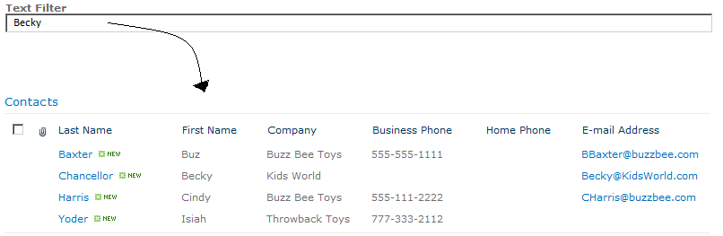
Connecting Web Parts
Connecting the Text Filter to the Contacts web part can be conditional on any of the text columns in the Contacts web part, such as the First Name column as in this illustration.
Notes:
A powerful method of employing web parts is to use two web parts together to provide interactivity on the web page. SharePoint users are more engaged when they can dynamically change the page display to best suit their use of its exposed data. SharePoint 2010 offers the ability to connect two web parts together based on common metadata or web part properties so that the values in one of the web parts influences the information that appears in the other web part.
For example, imagine you have employed the web part for a Contacts list on your web page. However, you would like your users to be able to trim the values seen in this web part based on the contact’s first name. This way, a given sales user could change the contents displayed in the Contacts web part quickly and easily to reflect the contact their looking for by first name. Adding a filter web part to the page and connecting that filter web part to the Contacts list’s web part, you can easily modify the page to accept input from the sales user into the filter that correspondingly trims the Contacts web part.

Slide 12
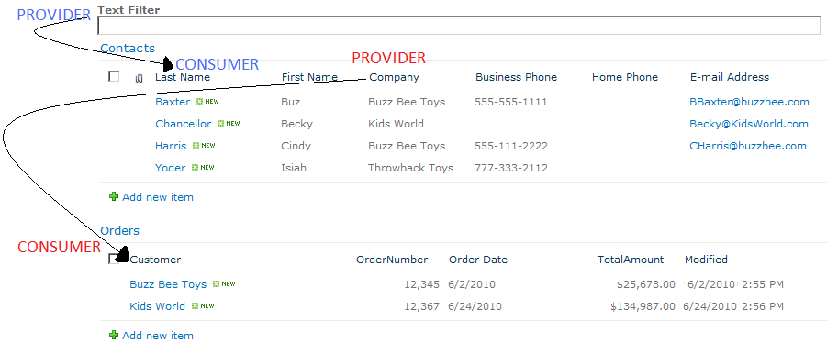
The Provider/Consumer Relationship
Notes:
When you connect two web parts together on a page, a provider/consumer relationship is established between the two web parts. One of the web parts will “feed” its value to another web part for some purpose. The web part being “fed” will take in that value from the providing web part and use it for some purpose (usually to sort, trim or otherwise organize its exposed content).
The web part that is providing a value to another web part is referred to as the Provider in the relationship. The web part taking in the value from the Provider is referred to as the Consumer in the relationship.
A given web part can be playing both roles albeit in separate relationships. For example, on the previous page in this lesson the Contacts list was a Consumer to the values being passed into it by the Text Filter web part (the Provider). But the Contacts list could additionally be configured in another separate relationship with the Orders list’s web part on the page as a Provider. In this second relationship, perhaps the Contacts list provides its Company value to trim the Orders web part to display only those orders for companies that have contacts defined.
Also, a given web part can play the same role in multiple relationships. For instance, on the previous page in this lesson the Contacts list could become a Consumer to both the Text Filter web part and an additional Date Filter web part that further filters the items exposed in the Contacts list based on the item’s Last Modified Date value.

Slide 13
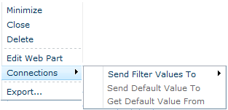
Configuring Providers
Specify:
Consumer
Content Type
Consumer Field
Notes:
To connect two web parts together you can either configure the Provider in the relationship or configure the consumer. For example, in the previous scenario of a Text Filter web part providing a filter value to the Contacts list web part, you can configure the filter as a Provider and no additional configuration will be required on the Contacts list web part.
You can connect a web part from its contextual menu, accessed by clicking the drop-down arrow on the right edge of the web part title bar. The Connections choice in this menu allows you to either send the web parts data to another web part (thereby configuring it as a Provider) or retrieve values from another web part (thereby configuring it as a Consumer).
When configuring a web part as a Provider in a connection, you must specify which other web part on the same web page will be the Consumer in the relationship. You must then specify the content type of the value being passed (except on Filter web parts that already define the value data type such as Text Filter or Date Filter). Lastly, you must identify the column in the Consumer web part that will take in the value for comparison, referred to in the Connections dialog windows as the Consumer Field.

Slide 14
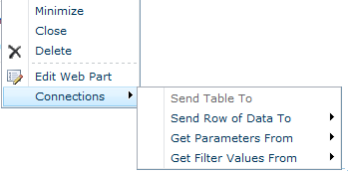
Configuring Consumers
Provider
Content Type
Provider Field
Consumer Field
Notes:
Alternatively, you can connect two web parts by configuring the Consumer in the relationship. For example, in the previous scenario of an Order list web part consuming the customer name from the Contacts list web part, you can configure the Order list web part as a Consumer and no additional configuration will be required on the Contacts list web part.
When you access the web part’s contextual menu and select the Connections choice in this menu you would need to click the option to “get” values from another web part to configure the web part as a Consumer. When configuring a web part as a Consumer in a connection, you must specify which other web part on the same web page will be the Provider in the relationship. You must then specify both the column in the Provider web part that will offer its values (referred to in the Connections dialog window as the Provider Field) and the column in the Consumer web part that will take in the values for comparison, referred to in the Connections dialog window as the Consumer Field.

Slide 15
DEMO
Connecting Web Parts
Notes:
In this demonstration the instructor will illustrate the process of connecting web parts together on a SharePoint site web page.

Slide 16
Agenda
The Purpose of Pages and Web Parts
A Tour of Default Web Parts
Connecting Web Parts
Targeting Web Parts

Slide 17
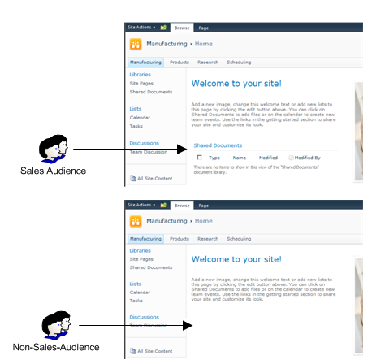
Targeting Web Parts
Notes:
Audience targeting is the practice of hiding or exposing a list item or web part based on the user viewing the web page. Audience targeting compares the logged on user’s identity against the memberships of audience(s) configured for the web part and if the user is a member of at least one of the named audiences on the web part configuration, then the web part appears for that user. If the logged on user is not a member of at least one of the named audiences on the web part configuration, the web part does not appear on the page for that user.
A web part can be configured to appear only to specific audiences by entering the audience name(s) into the Target Audiences field under the Advanced heading of the web part’s configuration settings.
Not to be confused with security, audience targeting in no way prevents a user from getting to the content exposed in the web part. For example, if a Calendar list’s web part on the Sales Web Page has been audience targeted to the Sales audience and a user who is not a member of the Sales audience logs into the page then that user will not see the Calendar list web part. But this does not prohibit the user from navigating to another web page that also displays the Calendar list’s web part but without audience targeting and learning of new Sales events there. The user may also choose to navigate to one of the Calendar list’s view pages to see what events are in the Calendar. If the user who is not a member of the Sales audience has at least Read permission to the Calendar list and its items, then that user can conceivably access the list via a method other than the audience targeted web part.

Slide 18
What is an Audience?
Named collection of users
SharePoint Groups
Configured in security architecture
Used for granting permissions
Directory Service Groups
Objects in the directory service supporting SharePoint
Memberships based on resource needs
Sometimes used for granting permissions to resources
Global Audiences (compiled)
Defined by SharePoint server administrators
Members are otherwise unrelated (not in the same directory or SharePoint groups with each other)
Notes:
An Audience is a named collection of user accounts that have access to the site and need to the same level of access to the same web part or list item. SharePoint recognizes three possible audience resources: SharePoint security groups, group objects from the Directory Service supporting SharePoint (such as Microsoft Active Directory), and Global audience objects defined in the SharePoint application services by a SharePoint Farm Administrator.
Before creating audiences and invoking audience targeting it is important to remember that, by default, all SharePoint web pages are security trimmed. So if the web part you are concerned about happens to be a list web part, then the permissions defined for the list will take care of exposing that list’s web part content only to authorized users. However, if the web part you are working with is a web part other than a list web part, there is no setting in a web part’s configuration pane for assigning permissions to the web part. For these web parts audience targeting may be your only option of hiding the web part’s content from inappropriate users.
Audience targeting is also a useful tool for steering users toward specific content without interrupting or corrupting security permission assignments. Since users will tend to use what’s right in front of them, making the most appropriate web parts appear to the groups of users that will most utilize them can improve end user productivity without the need to design extraneous pages.

Slide 19
DEMO
Audience Targeting
Notes:
In this demonstration, your instructor will illustrate:
How to identify potential web part audiences.
How to target a web part to a particular audience.

Slide 20
Summary
The Purpose of Pages and Web Parts
A Tour of Default Web Parts
Connecting Web Parts
Targeting Web Parts

